Slide 1


Abstra
Lazar Milicevic
Weekly support report
Support, Challenges, Sollutions
25.03.2025

Slide 2
Agenda
1. Owkin K Platform: Help Center, Documentation, and Widget
3. Dataset Form in Zendesk
5. Challenges & Solutions
7. Q&A
2. Zendesk Ticketing Workflow Improvements
4. Hackathon Access Update
6. Next Steps & Focus Areas

Slide 3
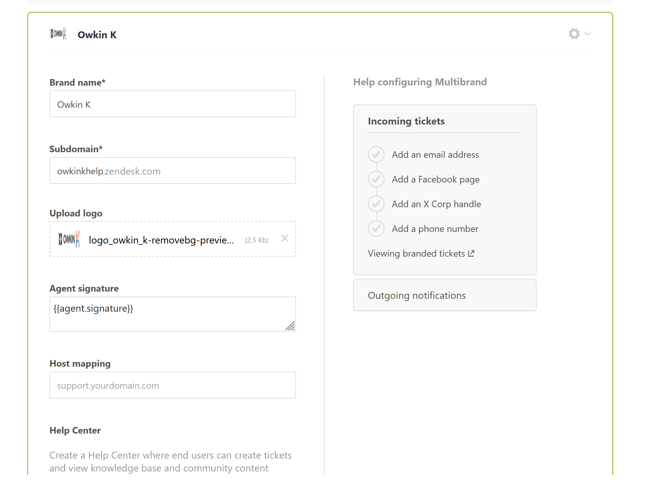
Owkin K Platform: Help Center, Documentation, and Widget
Customer success: Weekly Support Report – 25.03.2025
What was done:
✅ Help Center Visibility & Content Updates
Help Center access was updated – it is now available only to users with JumpCloud accounts, based on internal feedback.
A dedicated instance of the Help Center was created and launched for Owkin K.
20 FAQ articles were created and published to address common onboarding and usage questions.
The initial support article was published to help guide new users through the platform.
Visual and branding updates were applied to ensure consistency with the Owkin K identity.
A new Zendesk ticket submission form was created specifically for Owkin K-related requests, with optimized logic and input fields for efficient routing.

Slide 4
Owkin K Platform: Help Center, Documentation, and Widget
Customer success: Weekly Support Report – 25.03.2025
What was done:
✅ Documentation Progress & Testing
Finalized the structure and content of the Owkin K User Guide.
Conducted live testing of tools during the documentation process.
Identified bugs and reported them via the k-incidents Slack channel for developer review.
Uploaded finalized documentation to the Zendesk Knowledge Base.
✅ SurveySparrow Widget – Integration
Created and branded two surveys for Owkin K Staging and Dev environments.
The widget was successfully integrated and is now live in Staging, following multiple meetings with the SurveySparrow team and Jérémy.
Next Step: Review feedback, finalize widget functionality, and proceed with license decision and production deployment.

Slide 5
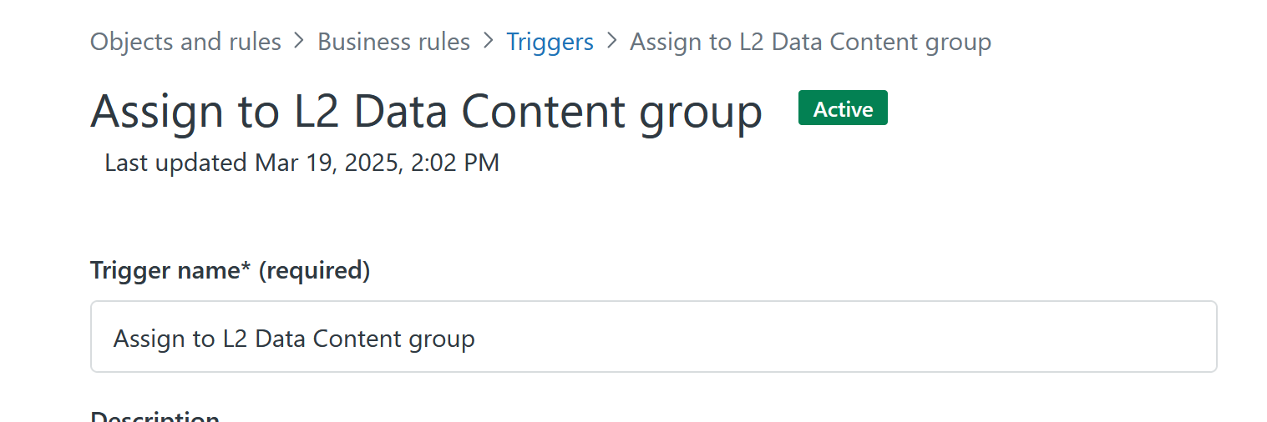
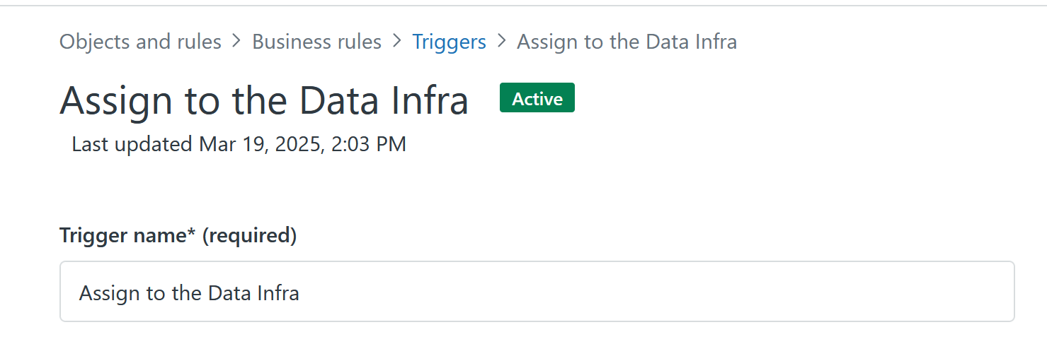
Zendesk Ticketing Workflow Improvements
Customer success: Weekly Support Report – 25.03.2025
Where we are now ?
✅ Automation Enhancements
Resolved form submission issues within Zendesk.
Implemented new automated triggers to assign incoming tickets directly to the appropriate teams:
  L2 Data Content
  DataOps
  Data Infra
✅ Rotation Management
Completed Zendesk agent rotation in accordance with the official rotation table.
Coordination was carried out with L2 engineers from all squads to ensure balanced ticket distribution and optimal support coverage.

Slide 6
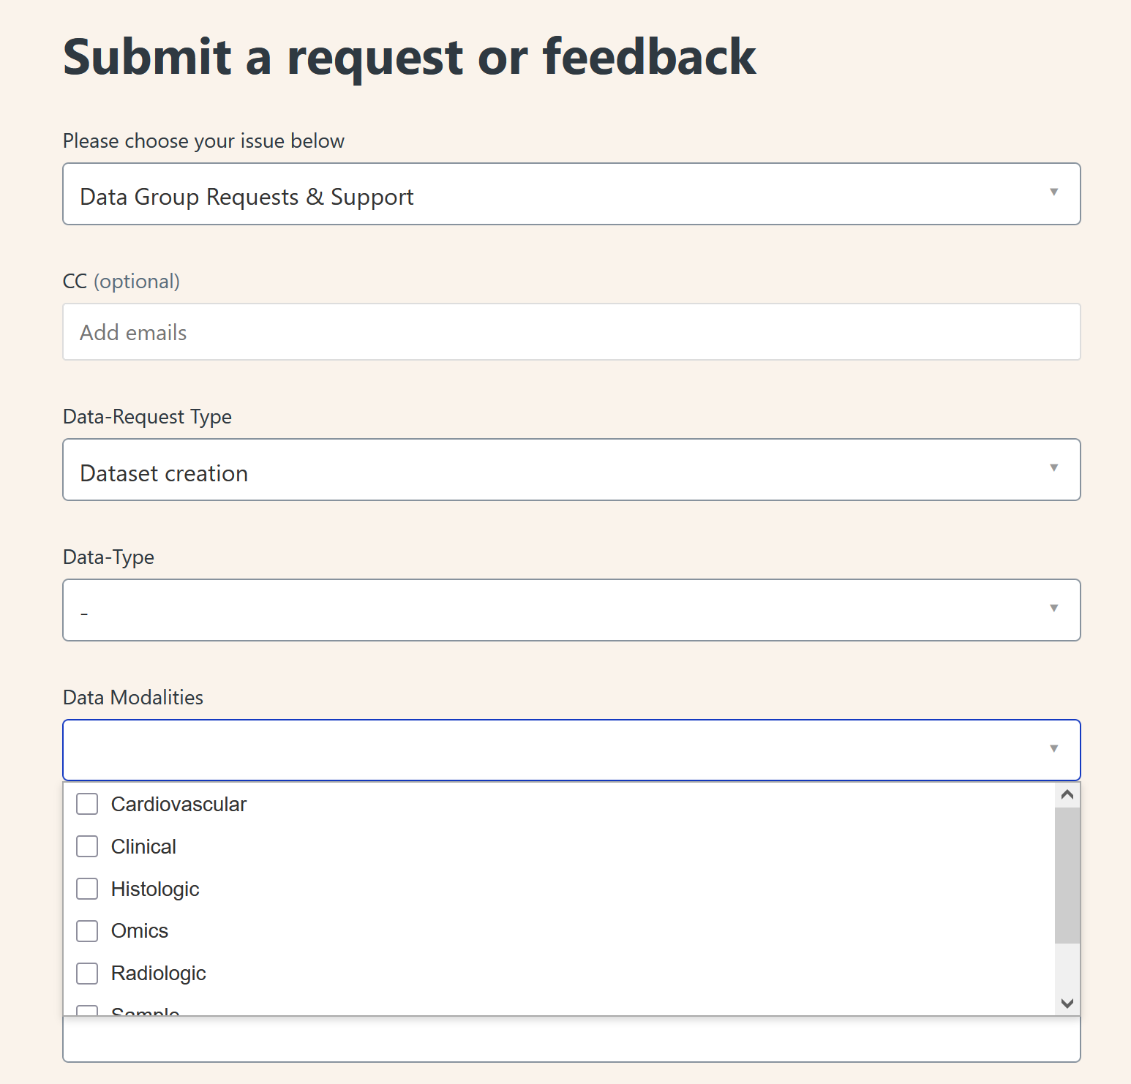
Dataset Form in Zendesk
Customer success: Weekly Support Report – 25.03.2025
Where we are now ?
✅ New Dataset Request Workflow Now Live
Developed the form in collaboration with Anastasia Lieva, replacing the previous process in Abstra.
Created new squads in Zendesk:
  Data Content
  Data Infrastructure
Streamlined field structure: standardized naming conventions, removed redundant options, and made Dataset ID optional except for dataset creation requests.

Slide 7
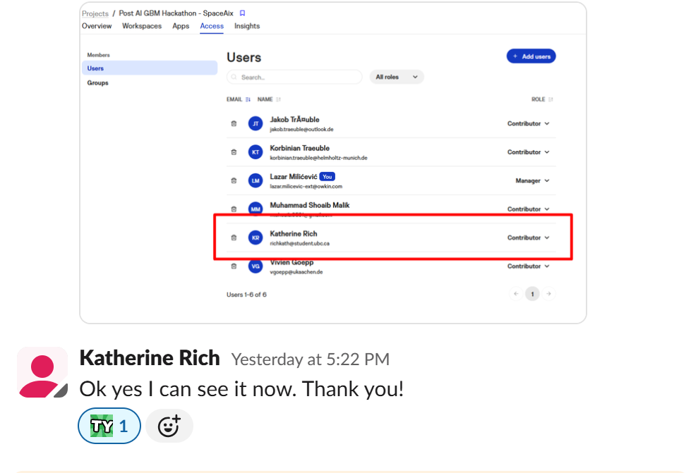
Hackathon Access Update
Customer success: Weekly Support Report – 25.03.2025
Some of them:
✅ New Access and Ongoing Support
Enabled Abstra access for Katarina, a Hackathon winner who later became involved in the Abstra platform.
Provided her with step-by-step guidance on how to access and navigate the Abstra environment.
Granted her access to her team's project, including a walkthrough of where and how to find relevant components.
Explained the process for interacting with the project and submitting related support requests.

Slide 8
Challenges & Solutions
Customer success: Weekly Support Report – 25.03.2025
What will be done:
🔹 Challenge: The Owkin K Help Center was initially fully public.
✅ Solution: Access was restricted to authenticated users via JumpCloud.
🔹 Challenge: Ticket routing in Zendesk lacked automation.
✅ Solution: Introduced new triggers to assign tickets based on request type.
🚀 Ongoing Focus:
Improving UI/UX and form usability in Zendesk
Increasing workflow automation
Reducing manual support interventions through better documentation

Slide 9
Next Steps & Focus Areas
Customer success: Weekly Support Report – 25.03.2025
What will be done:
📌 Zendesk
Monitor new form usage and refine field structure
Continue optimization of ticket routing and trigger logic
📌 Owkin K Documentation
Conduct internal review and finalize
Prepare for re-publication within the Help Center
📌 SurveySparrow
Conclude final testing and refinement
Make license decision and roll out to production
🚀 Main Focus:
Scaling automation, improving platform accessibility, and making processes better, and more efficient.

Slide 10

Q&A
Customer success: Weekly Support Report – 25.03.2025
?
Can I close it?
🔗 Zendesk Ticket #4465

Slide 11
Thank you!

